Slide 1
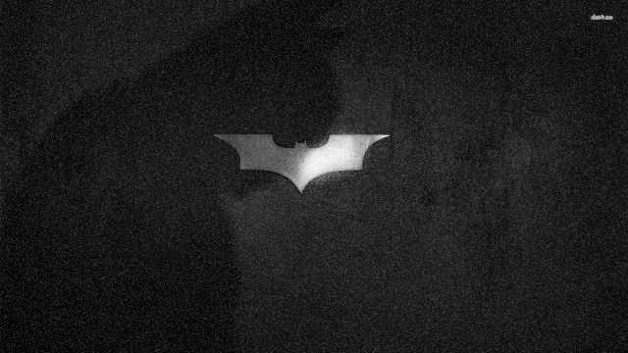
Perpetual Futures

Slide 2
Why do we need perpetual contracts?
Imagine a scenario where your friends tell you about a new asset called Bitcoin and its price is surging. What are the choices we have to speculate on the price of this asset?
Choice #1: Spot Market
Choice #2: Options Market
Choice #3: Futures Market

Slide 3
Futures Market?
futures contract, which gives you the obligation to either
1.(physical delivery) buy or sell a certain amount of an asset at a specific price at the contract expiration date, or
2.(cash settlement) receive or pay the net cash difference between the spot price and the pre-determined price on the contract at the expiration date.
Unlike options contracts, futures contracts are tradable before the expiration date.

Slide 4
Improving upon this drawback, BitMEX invented a new financial instrument called the perpetual contract, which is similar to a futures contract but without the expiration date, meaning that traders can now hold this futures-like contract indefinitely (or perpetually) without the need to roll-over the contract.

Slide 5
Perpetual Contracts
A futures contract is an agreement to buy or sell a commodity, currency, or another instrument at a predetermined price at a specified time in the future.
A perpetual contract is a special type of futures contract, but unlike the traditional form of futures, it doesn’t have an expiry date. So one can hold a position for as long as they like.
Other than that, the trading of perpetual contracts is based on an underlying Index Price.

Slide 6
The Index Price consists of the average price of an asset, according to major spot markets and their relative trading volume. Thus, unlike conventional futures, perpetual contracts are often traded at a price that is equal or very similar to spot markets.
However, during extreme market conditions, the mark price may deviate from the spot market price.
Still, the biggest difference between the traditional futures and perpetual contracts is the ‘settlement date’ of the former.

Slide 7
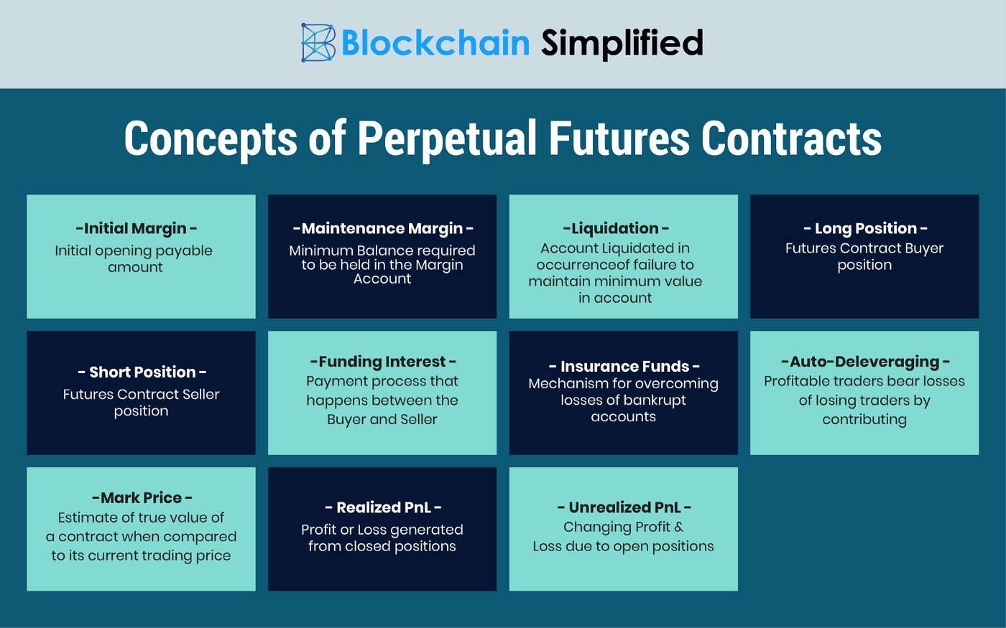

Slide 8
What is the Leverage?
Leverage is an investment strategy of using borrowed money—specifically, the use of various financial instruments or borrowed capital—to increase the potential return of an investment. Leverage can also refer to the amount of debt a firm uses to finance assets.

Slide 9
What is the initial margin?
Initial margin is the minimum value you must pay to open a leveraged position.
For example, you can buy 1,000 BNB with an initial margin of 100 BNB (at 10x leverage). So your initial margin would be 10% of the total order.
The initial margin is what backs your leveraged position, acting as collateral.

Slide 10
What is the maintenance margin?
Maintenance margin is the minimum amount of collateral you must hold to keep trading positions open.
If your margin balance drops below this level, you will either receive a margin call (asking you to add more funds to your account) or be liquidated.
In other words, the initial margin is the value you commit when opening a position, and the maintenance margin refers to the minimum balance you need to keep the positions open.
The maintenance margin is a dynamic value that changes according to market price and to your account balance (collateral).

Slide 11
What is liquidation?
If the value of your collateral falls below the maintenance margin, your futures account may be subject to liquidation.
Depending on the exchange you use, the liquidation occurs in different ways.
In general, the liquidation price changes according to the risk and leverage of each user (based on their collateral and net exposure).
The larger the total position, the higher the required margin.
To avoid liquidation, you can either close your positions before the liquidation price is reached or add more funds to your collateral balance - causing the liquidation price to move further away from the current market price.

Slide 12
What is PnL?
PnL stands for profit and loss, and it can be either realized or unrealized.
When you have open positions on a perpetual futures market, your PnL is unrealized, meaning it’s still changing in response to market moves.
When you close your positions, the unrealized PnL becomes realized PnL (either partially or entirely).
Because the realized PnL refers to the profit or loss that originates from closed positions, it has no direct relation to the mark price, but only to the executed price of the orders.
The unrealized PnL, on the other hand, is constantly changing and is the primary driver for liquidations.

Slide 13
What is the Insurance Fund?
Simply put, the Insurance Fund is what prevents the balance of losing traders to drop below zero, while also ensuring that winning traders get their profits.
The liquidation fees go directly to the Insurance Fund, and any remaining funds are returned to the users.
So, the Insurance Fund is a mechanism designed to use the collateral taken from liquidated traders to cover losses of bankrupt accounts.

Slide 14
What is the mark price?
The mark price is an estimate of the true value of a contract (fair price) when compared to its actual trading price (last price).
The mark price calculation prevents unfair liquidations that may happen when the market is highly volatile.
So while the Index Price is related to the price of spot markets, the mark price represents the fair value of a perpetual futures contract.
The calculation of Mark Price is intricately linked to the Funding Rate and vice versa.

Slide 15
As Unrealized PNL is the primary driver of liquidations, it is important to ensure that the Unrealized PnL calculation is accurate to avoid unnecessary liquidations. The underlying contract for the Perpetual Contract is the ‘true’ value of the Contract, and an average of the prices on the major markets constitutes the “Price Index” which is the primary component of Mark Price.
The Price Index is a bucket of prices from the major Spot market exchanges, weighted by their relative volume. The Price Index for USDⓈ-M futures contracts derived prices from Huobi, Bittrex, HitBTC, Gate.io, Bitmax, Poloniex, FTX, MXC.

Slide 16
When it is unable to obtain a stable and reliable source of reference data for "Price Index" and "Mark Price", for those contracts that have a single source of Price Index, the Price Index will not be updated. We will use a mechanism called “Last Price Protected" to update the Mark Price until it is back to normal.
The “Last Price Protected” is a mechanism that the matching system temporarily switches to the latest transaction price of the contract itself within a certain limit as reference for Mark Price, to calculate unrealized profit and loss and liquidation call level, in order to avoid unnecessary liquidation.

Slide 17
Mark price formula for perpetual futures contracts is as follows:
Mark price = Median* (Price 1, Price 2, Contract Price)
Price 1 = Price Index * (1 + Last Funding Rate * (Time Until Funding /8))
Price 2 = Price Index + Moving Average (30-minute Basis)*
*Moving Average (30-minute Basis) = Moving Average ((Bid1+Ask1)/2- Price Index), which measures every minute in a 30-minute interval
*Median: If Price 1 < Price 2 < Contract Price, then take Price 2 as Mark price.
Please note that due to extreme market conditions or deviations in price sources, which may lead to mark price deviate from the spot price, Binance will take additional protective measures, i.e. Mark price = Price 2 in this scenario.

Slide 18
What is the funding rate?
Funding rates are periodic payments made to either long or short traders, calculated based on the difference between the perpetual contract prices and spot prices.
When the market is bullish, the funding rate is positive and tends to rise over time. In these situations, traders who are long on a perpetual contract will pay a funding fee to traders on the opposing side.
Conversely, the funding rate will be negative when the market is bearish, where traders who are short on a perpetual contract will pay a funding fee to long traders.

Slide 19
Why is Funding Rate important?
Funding rate is primarily used to force convergence of prices between the perpetual contract and the underlying asset.
Unlike traditional futures, perpetual contracts have no expiration date. Traders can hold positions to perpetuity unless they get liquidated, making trading perpetual contracts very similar to spot trading.
As such, crypto exchanges created a mechanism to ensure that perpetual contract prices correspond to the index, which is known as Funding Rate.

Slide 20
How are Funding Rates calculated on Binance?
Funding rates are calculated using the following formula:
Funding Amount = Nominal Value of Positions × Funding Rate
(Nominal Value of Positions = Mark Price x Size of a Contract)
Please note that Binance takes no fees from funding rate transfers as funding fees are transferred directly between traders.
Funding payments occur every 8 hours at 00:00 UTC; 08:00 UTC and 16:00 UTC for all Binance Futures perpetual contracts.
Traders are only liable for funding payments in either direction if they have open positions at the pre-specified funding times. If traders do not have a position, they are not liable for any funding. Moreover, traders who close their positions prior to the funding time will not pay or receive any funding.

Slide 21
Types of perpetual contract exchanges
And there are two main types of perpetual contract exchanges — the orderbook type and the automated market maker (AMM) type.
Orderbook-Based (Peer-to-peer)
AMM-Based (Peer-to-pool)

Slide 22
Orderbook-Based (Peer-to-peer)
Nearly all of the centralized players belong to this category, including FTX, Binance, BitMEX, and Deribit. The way an orderbook-style exchange works is that each trader can place orders on a centralized orderbook, and the exchange’s matching engine will match the buy and the sell orders from different traders.
Pros:
1.Faster matching speed (CEX)
2.Diverse order types (market order, limit order, stop-loss order, etc)
3.Easier to use
Cons:
1.Requires identity verification (KYC)
2.Not transparent

Slide 23
AMM-Based (Peer-to-pool)
New entrants from the DeFi world such as Perpetual Protocol ) and MCDEX are adopting this model where the counterparty on each trade is a pool of assets, known as an automated market maker (AMM). Unlike orderbook-based exchanges where the price of a perpetual contract is determined by one sell order and one buy order, prices on an AMM type exchange are determined by a predefined formula.
Pros:
1.No need for identity verification
2.Transparent mechanism
Cons:
1.Market orders only
2.Harder to use (you need to have a token wallet; exchange mechanism may feel unintuitive at first)

Slide 24
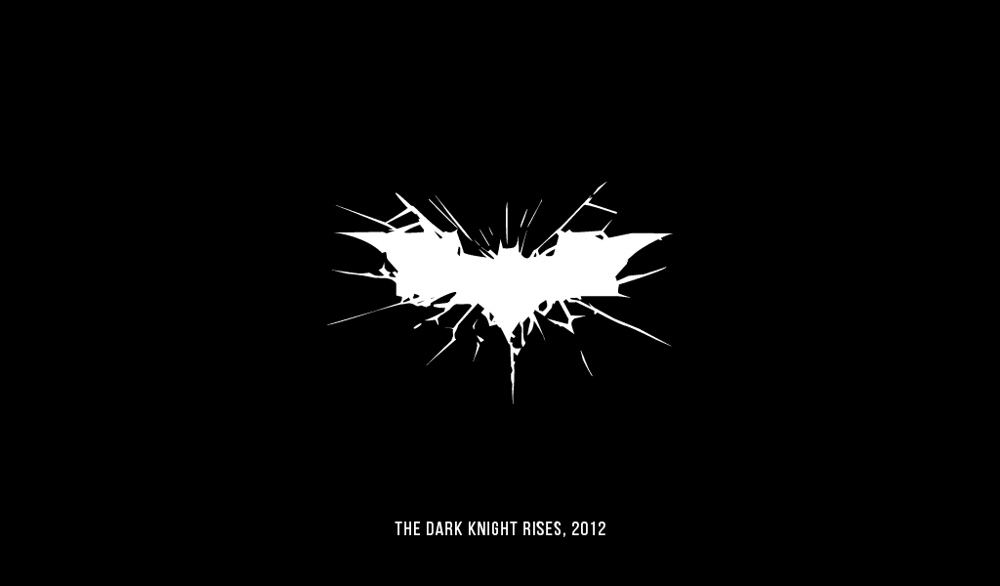
Thank you !

